Slide 1

Unit -2
Process Management

Slide 2
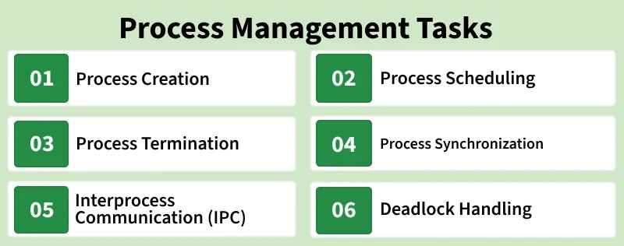
Introduction of Process Management
Process management is a core function of an Operating System (OS). It deals with creating, scheduling, and coordinating processes to ensure efficient CPU utilization and smooth system performance.
Single-tasking systems are easy to manage since only one process runs at a time.
Multiprogramming/multitasking systems are more complex, as multiple processes need to share the CPU efficiently.
Active processes may share memory and other resources, requiring careful management.
Process synchronization is necessary when processes interact or communicate to avoid conflicts.

Slide 3
Process Management Tasks
Process management is a key part in operating systems with multi-programming or multitasking.
Process Creation and Termination: Process creation involves creating a Process ID, setting up Process Control Block, etc. A process can be terminated either by the operating system or by the parent process. Process termination involves clearing all resources allocated to it.
CPU Scheduling: In a multiprogramming system, multiple processes need to get the CPU. It is the job of Operating System to ensure smooth and efficient execution of multiple processes.
Deadlock Handling: Making sure that the system does not reach a state where two or more processes cannot proceed due to cyclic dependency on each other.
Inter-Process Communication: Operating System provides facilities such as shared memory and message passing for cooperating processes to communicate.
Process Synchronization: Process Synchronization is the coordination of execution of multiple processes in a multiprogramming system to ensure that they access shared resources (like memory) in a controlled and predictable manner.

Slide 4
Process Management
Process management in operating system is about managing processes. A Process is a running program. The life cycle of process is from the moment program start until it finishes.
Creates, schedules, and terminates processes.
Allocates CPU time to different programs.
Supports multitasking.
Example: Running a web browser and a music player simultaneously

Slide 5
Program vs process
1. Program
A program is a set of instructions written in a programming language and stored on a storage device (hard disk or SSD). It is a passive entity because it does not execute until it is loaded into memory.
Characteristics
Stored on secondary memory.
Static (does not change while stored).
Contains instructions only.
Becomes a process when executed.
Example :calculator.exe , student.c ,python.exe
Step 1: Program
Suppose Microsoft Word is installed on your laptop.
The file WINWORD.EXE is stored on your hard disk.
It is just a collection of instructions.
It is not running.
This is called a Program.

Slide 6
Cont..
2. Process
A process is a program that is currently being executed. It is an active entity because it uses CPU, memory, and other system resources.
Characteristics
Loaded into main memory (RAM).
Dynamic (changes during execution).
Has its own Process ID (PID).
Uses CPU time, memory, files, and I/O devices.
Example
When you open Google Chrome, each running tab is a separate process.
Step 2: Process
Now double-click Microsoft Word.
Windows loads Word into RAM.
CPU starts executing it.
A Word window appears.
Now it becomes a Process.

Slide 7
Difference Between Program and Process
Program | Process
Passive entity | Active entity
Stored on disk | Stored in RAM
Static | Dynamic
No execution | Currently executing
No resources allocated | Resources allocated (CPU, memory, I/O)
One program can create many processes | Created from a program

Slide 8
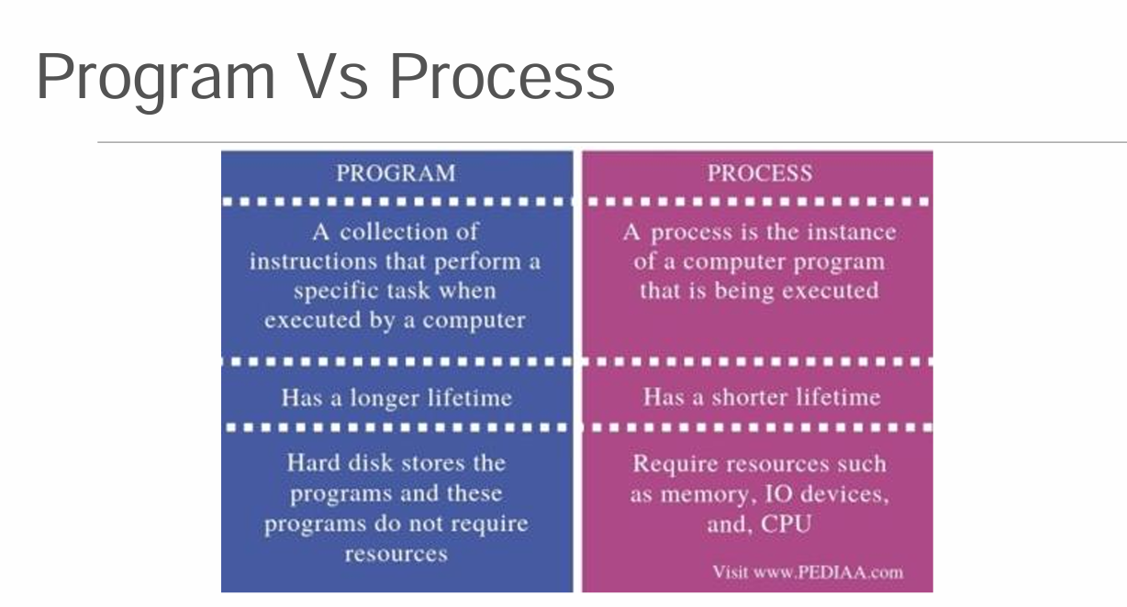
Cont..

Slide 9
Process States
A process passes through several states during execution.
New
|
v
Ready
|
v
Running
/ \
/ \
Waiting Terminated
|
|
v
Ready

Slide 10
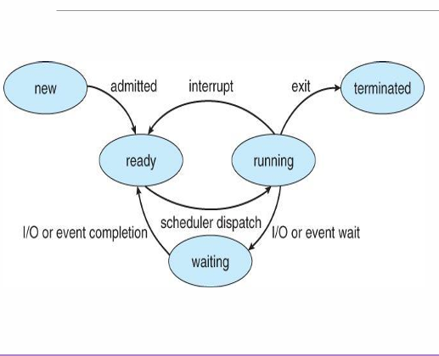
Cont…
1. New State :The process is in the stage of being created.
Process is being created.
OS allocates resources.
Example: Double-clicking a program icon.
2. Ready State :The process has all the resources available that
it needs to run, but the CPU is not currently working
on this process's instructions.
Process is loaded into memory.
Waiting for CPU allocation.
Example: Multiple applications waiting for CPU.
3.Running State :The CPU is working on this process's instructions
CPU is executing the process.
Example: Typing in Microsoft Word.

Slide 11
Cont..
4. Waiting (Blocked) State
The process cannot run at the moment, because it is waiting for some resource to become available or for some event to occur.
Process waits for an event such as:
  Keyboard input
  File read/write
  Printer
  Network response
After the event completes, it returns to the Ready state.
5. Terminated (Exit) State
The process has completed.
Process finishes execution.
Operating system releases all allocated resources.

Slide 12
Process Control Block:
A Process Control Block (PCB) is a data structure maintained by the operating system that stores all the information required to manage a process.
Without the PCB, the OS cannot manage or resume a process.
Information Stored in PCB
The Attributes of the process are used by the Operating System to create the process control block (PCB).
This is also called context of the process.
Attributes which are stored in the PCB are described in the diagram:

Slide 13
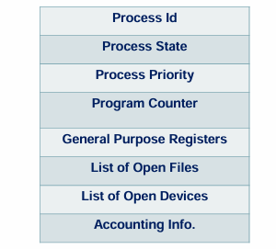
Cont..

Slide 14
Cont..
1.Process ID
When a process is created, a unique id
is assigned to the process which is used
for unique identification of the process
in the system.
Example: Chrome → PID = 2345
Notepad → PID = 3245
2. Program counter
While running processes when the context switch
occurs, the next instruction to be executed is stored
in the program counter which helps in resuming
the execution of the process from where it left off

Slide 15
Cont..
3. Process State: current status of the process.
There are different states for a process which are
“new”, “ready”, “running” or “waiting”
Helps to manage the processes and schedule them
4. Priority:
Every process has its own priority. The process
with the highest priority among the processes
gets the CPU first. This is also stored on the
process control block.
5. General Purpose Registers
Every process has its own set of registers which
are used to hold the data which is generated
during the execution of the process

Slide 16
Cont..
6. List of Open Files:
During the Execution, Every process uses
some files which need to be present in the
main memory. OS also maintains a list of
open files in the PCB.
7. List of Open Devices:
OS also maintain the list of all open devices
which are used during the execution of the process..
8. Accounting Information:
The information such as CPU time, memory usage,
etc helps the OS to monitor the performance of
the process.
This keeps track of resource usage by the process.

Slide 17
Why is PCB Important?
Tracks all running processes.
Enables context switching between processes.
Helps the scheduler decide which process runs next.
Stores process information safely while the process is paused.
Context Switching Using PCB
Running Process A
|
Save CPU Registers
|
Store Information in PCB
|
Load PCB of Process B
|
Restore Registers
|
Process B Starts Running

Slide 18
OS services
Operating System Services
An Operating System (OS) provides various services to users and application programs to make computer systems easy and efficient to use.
The OS coordinates the use of hardware and application programs for users.
It provides a platform for running application software.
It is a set of special programs that help the computer function properly.
It controls input–output devices and system operations.
It manages program execution and file handling

Slide 19
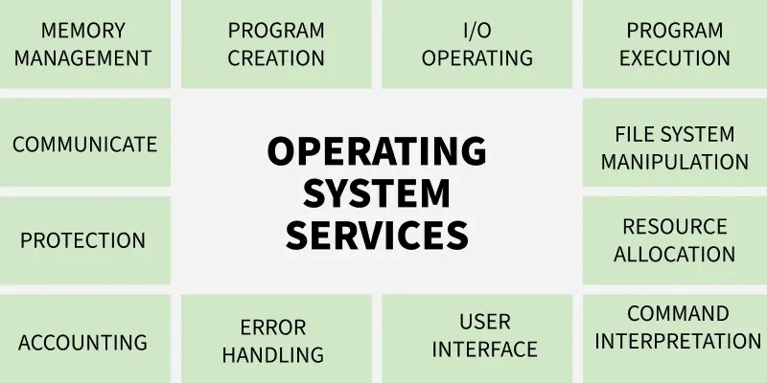
Cont..
.

Slide 20
Cont..
1. Program Execution
Loads programs into memory for execution.
Uses CPU scheduling algorithms (FCFS, SJF, etc.) to decide execution order.
Handles and prevents deadlocks during execution.
Manages system resources for efficient overall functioning.
Terminates the program after execution.
Example: Running a C program or opening Google Chrome.
2. Input Output Operations
Manages all input-output operations.
Communicates with hardware through device drivers.
Ensures proper coordination between devices and the system.
Provides programs controlled access to input-output devices.
Provides a uniform interface for hardware devices.
Examples:
Keyboard, Mouse, Printer , Monitor

Slide 21
Cont..
3. Communication Between Processes
Manages inter-process communication (IPC).
Enables data transfer between processes.
Supports communication across networked computers.
Ensures secure and efficient information exchange.
Supports:
  Shared Memory
  Message Passing
Example: Two programs exchanging data.
4. File System Manipulation
Grants programs file access with permissions like read-only or read-write.
Allows users to create, delete, and organize files.
Manages file storage across devices such as hard disks and pen drives.
Decides how data is stored and manipulated for efficient file management.
Organizes files into directories.
Examples:
Create a file, Rename a folder, Delete a document

Slide 22
Cont..
5. Memory Management
OS checks whether a new program meets the requirements to get memory.
It decides how much memory the program needs.
Loads the program into a suitable memory location.
Prevents programs from using unnecessary or extra memory.
6. Process Management
CPU is like the kitchen stove where execution happens.
OS (chef) ensures each program gets fair execution time.
Prevents any program from occupying the CPU for too long.
Schedules all programs efficiently to keep the system running smoothly.
7. Security and Privacy
Security:
Blocks unauthorized access to the system.
Protects against viruses and malware.
Uses firewalls and antivirus tools for defense.
Ensures overall system and data safety.
Examples: User login, Password authentication, File permissions

Slide 23
Cont..
Privacy
Keeps personal data hidden from others.
Provides access control options like passwords.
Ensures only authorized users can view files.
Protects sensitive information from misuse.
8. Resource Allocation
Shares system resources among multiple processes.
Allocates CPU time using scheduling algorithms.
Manages memory and input-output devices.
Ensures efficient and proper use of all resources.
Allocates system resources such as: CPU, Memory, Disk , Printers

Slide 24
Cont..
9. User Interface
Provides both CLI and GUI for user interaction.
CLI uses a command interpreter to run user commands.
GUI offers windows, icons, and menus for easy use.
Helps users communicate smoothly with the operating system.
Provides an interface between the user and the computer.
Types:
  Command Line Interface (CLI)
  Graphical User Interface (GUI)
Example: Windows Desktop, Linux Terminal
10. Networking
Manages network connections between devices.
Supports internet access and communication.
Sends and receives data packets reliably.
Ensures smooth and stable network operations.

Slide 25
Cont..
11.Error Detection
Detects and handles CPU, memory, and I/O errors.
Prevents frequent errors and avoids deadlocks.
Fixes issues that occur during task execution.
Provides security measures against external threats and breaches.
Detects hardware and software errors.
Helps recover from failures.
Examples:
Disk read errors, Memory errors, Network failures
12. Time Management
Red light = programs waiting in the simple queue.
Yellow light = programs in the ready queue.
Green light = programs under execution.
OS changes states at proper intervals to ensure smooth program flow.

Slide 26
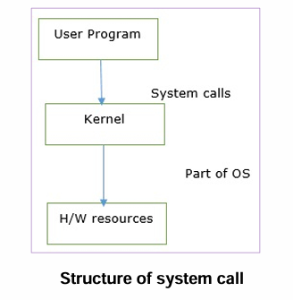
System Calls
System call provides an interface between user
program and operating system.
User program can access the kernel which is a part
of the OS through system calls.
Computer program can request a service from the kernel
of the operating system programmatically
A system call is a mechanism that allows a user program to
request services from the operating system kernel.
Process management system call allow an operating system
to create, terminate, and synchronize processes.
These system call help implement process creation,
parent –child relationships, and program exection.

Slide 27
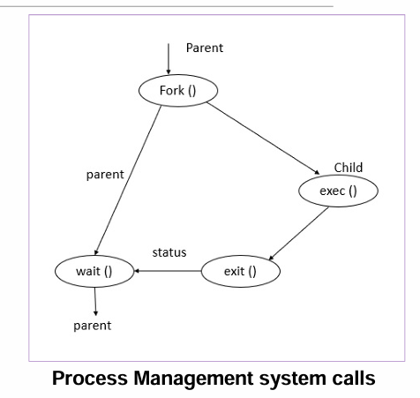
System Calls (fork, wait, exec, getpid, getppid etc.)
1.fork()
The fork() system call is used to create a separate, duplicate process.
Creates a new child process by duplicating the calling process.
Header File:
#include <unistd.h>
Syntax:
pid_t pid = fork();
Return Value:
Child process → return 0
In Parent → returns PID of child (positive integer)
On failure → return -1

Slide 28
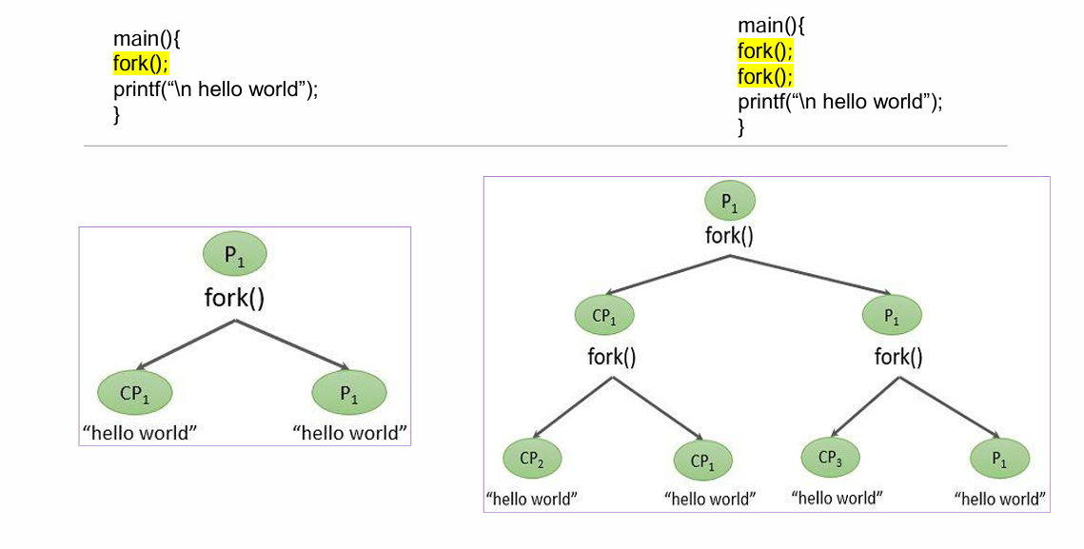
Cont..
.

Slide 29
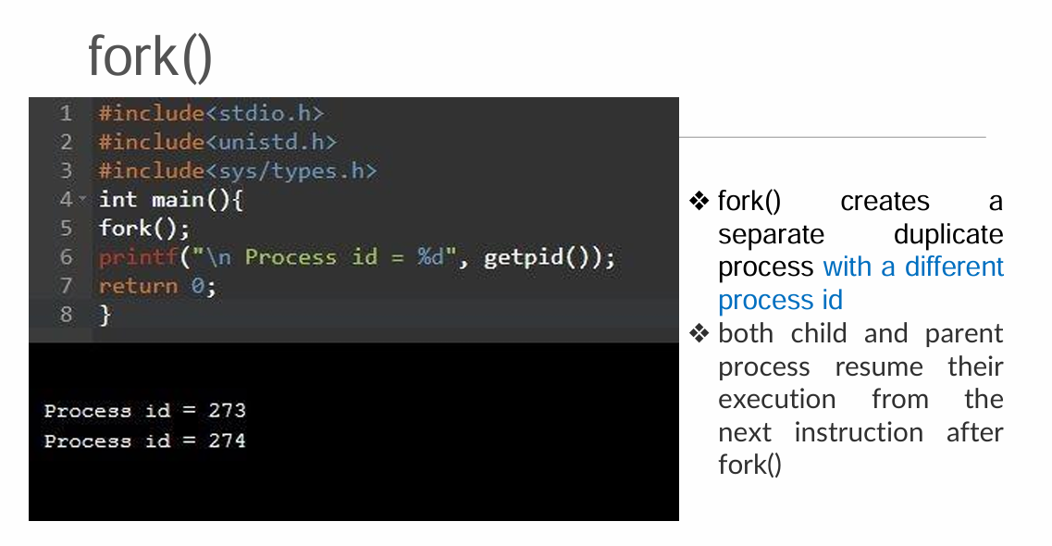
Cont..
.

Slide 30
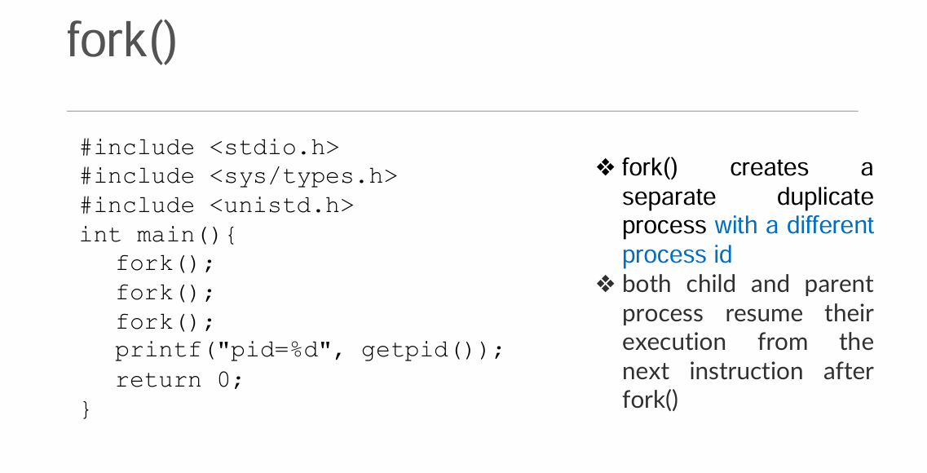
Cont..

Slide 31
Cont..
Example:
#include <stdio.h>
#include <unistd.h>
int main() {
pid_t pid = fork();
if (pid == 0)
printf("Child Process\n");
else
printf("Parent Process\n");
return 0;
}
Output:
Parent Process
Child Process

Slide 32
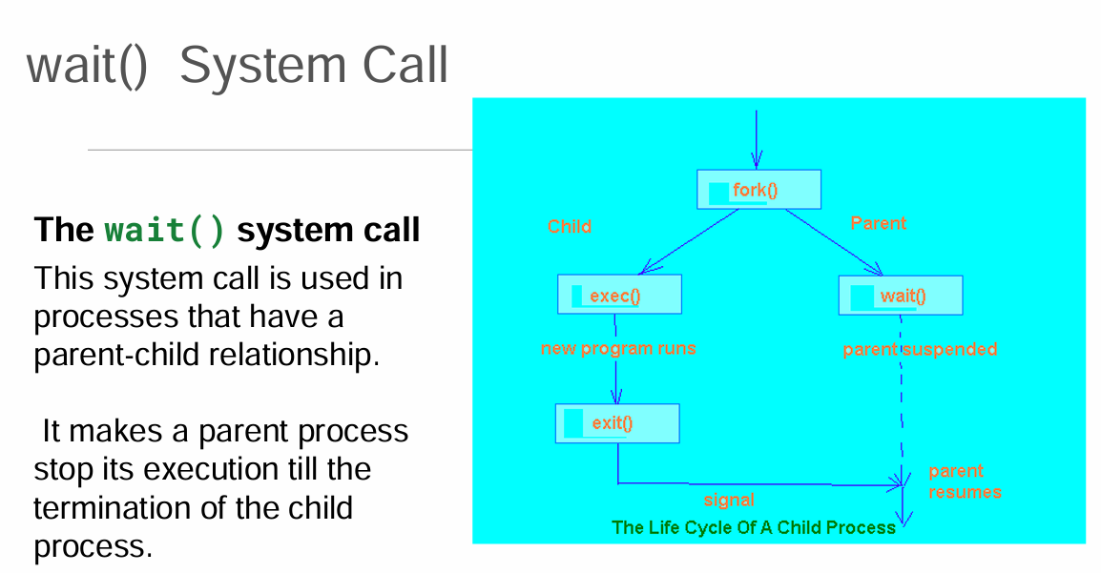
2.Wait()

Slide 33
Cont..
2. wait() :Makes the parent process wait until the child process finishes.
Header File: #include <sys/wait.h>
Syntax: wait(NULL);
Example:
#include <stdio.h>
#include <unistd.h>
#include <sys/wait.h>
int main() {
if (fork() == 0) {
printf("Child Process\n");
} else {
wait(NULL);
printf("Parent Process\n");
}
return 0;
}
Output: Child Process
Parent Process

Slide 34
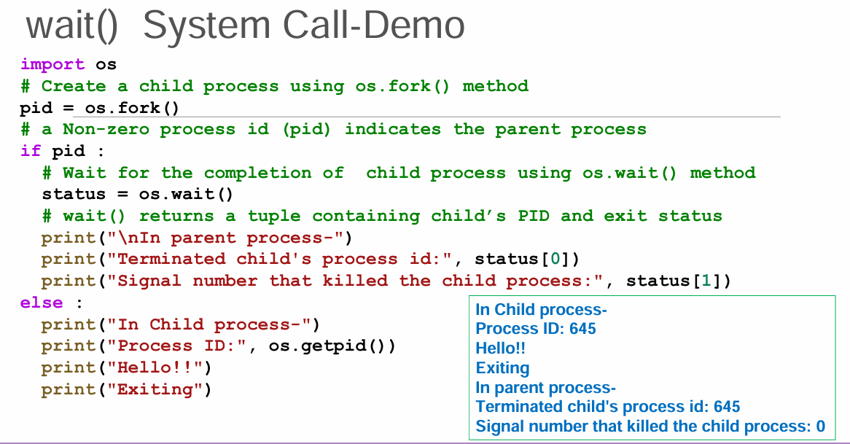
Cont..
.

Slide 35
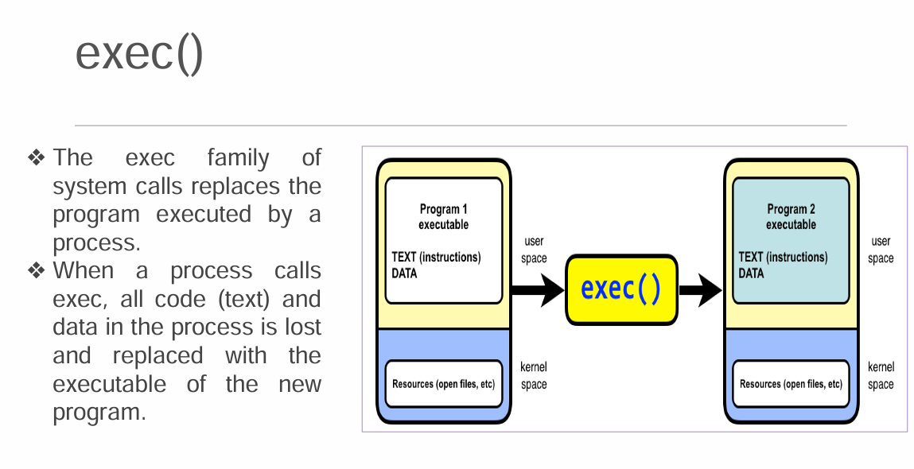
3.exec

Slide 36
Cont..
3. exec()
Replaces the current process image with a new program.
When an exec() system call is invoked, the program specified in the parameter to exec() will replace the entire process
There are several variants: execl(), execv(), execvp(), execle()
Example (execl):
#include <unistd.h>
int main() {
execl("/bin/ls", "ls", "-l", NULL);
return 0;
}
Output:Displays the output of the "ls -l" command.

Slide 37
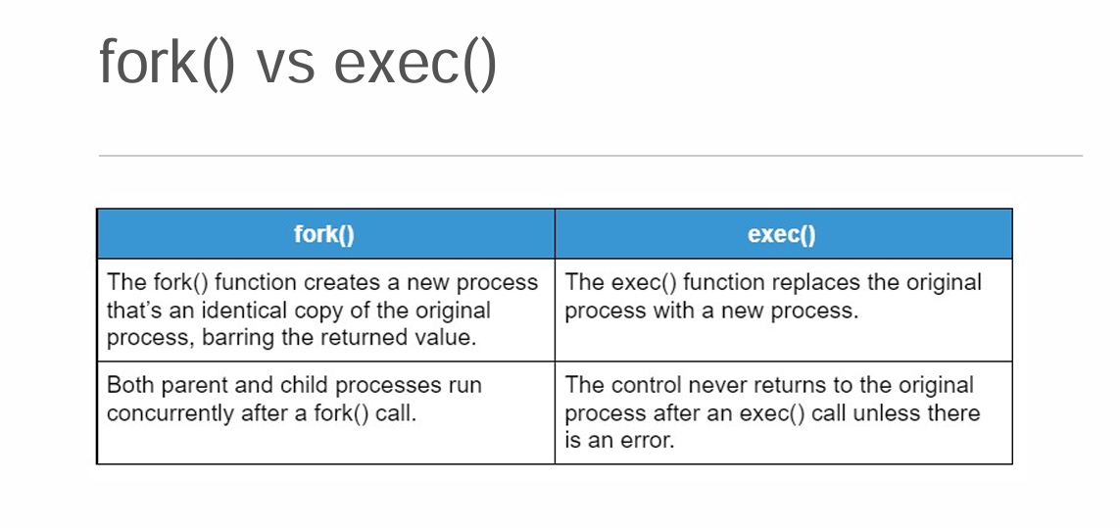
Cont..
.

Slide 38
4.exit
The exit() system call is used to terminate the process.
After the use of exit() system call, all the resources used in the process are retrieved by the operating system and then terminate the process.

Slide 39
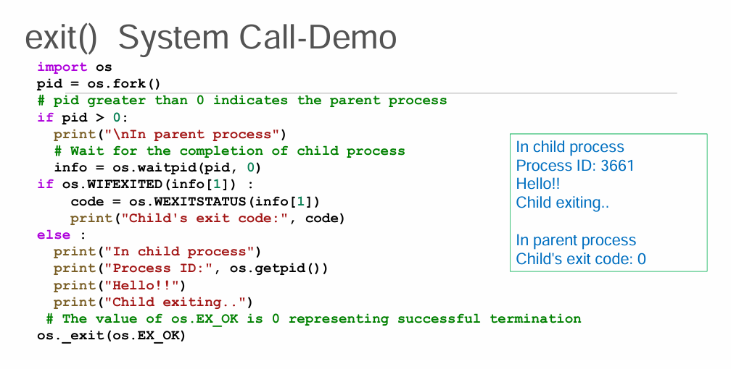
Cont..
.

Slide 40
Cont..
5. getpid()
Returns the Process ID (PID) of the calling process.
Header File: #include <unistd.h>
Example:
#include <stdio.h>
#include <unistd.h>
int main() {
printf("PID = %d\n", getpid());
return 0;
}
Sample Output: PID = 3456

Slide 41
Cont..
6. getppid()
Returns the Parent Process ID (PPID) of the calling process.
Example:
#include <stdio.h>
#include <unistd.h>
int main() {
printf("Parent PID = %d\n", getppid());
return 0;
}
Sample Output:
Parent PID = 1234

Slide 42
Cont..
fork(), wait(), getpid(), and getppid() Together
#include <stdio.h>
#include <unistd.h>
#include <sys/wait.h>
int main() {
pid_t pid = fork();
if (pid == 0) {
printf("Child PID : %d\n", getpid());
printf("Parent PID: %d\n", getppid());
} else {
wait(NULL);
printf("Parent PID: %d\n", getpid());
}
return 0;
}
Sample Output:
Child PID : 2450
Parent PID: 2449
Parent PID: 2449

Slide 43
Cont..
orphan process is a computer process whose parent process has finished or terminated, though it (child process) remains running itself.
A zombie process or defunct process is a process that has completed execution but still has an entry in the process table as its parent process didn't invoke an wait() system call.

Slide 44
System calls vs. System programs1
System Calls | System Programs
Interface between a user program and the OS kernel. | Utility programs provided by the operating system for users.
Invoked by application programs to request OS services. | Executed directly by users from the command line or GUI.
Part of the operating system kernel interface. | Run in user space using system calls internally.
Usually written in C and accessed through libraries (e.g., libc). | Standalone executable programs or utilities.
Low-level operations. | High-level user operations.
Cannot be executed directly from the shell. | Can be executed directly by users.
Faster because they directly enter kernel mode. | Slightly slower because they invoke one or more system calls.
Examples: fork(), exec(), wait(), read(), write(), open(), close(). | Examples: ls, cp, mv, rm, mkdir, ps, top, gcc.

Slide 45
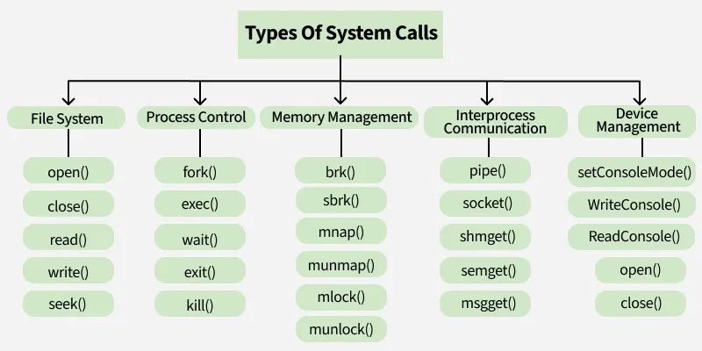
Cont..
Services provided by an OS are typically related to any kind of operation that a user program can perform like creation, termination, forking, moving, communication, etc. Similar types of operations are grouped into one single system call category. System calls are classified into the following categories:

Slide 46
Cont..
What are System Calls?
A system call is a function that allows a user program to request services from the operating system kernel.
Examples
fork() – Creates a new process.
exec() – Replaces the current process with a new program.
wait() – Waits for a child process to finish.
read() – Reads data from a file.
write() – Writes data to a file.
open() – Opens a file.
close() – Closes a file.

Slide 47
Cont..
What are System Programs?
System programs are utilities supplied by the operating system that provide a convenient environment for users to perform common tasks.
Examples
ls – List files and directories.
cp – Copy files.
mv – Move or rename files.
rm – Delete files.
mkdir – Create directories.
ps – Display running processes.
top – Monitor system performance.
gcc – Compile C programs.

Slide 48
Process scheduling
Maximize CPU use, quickly switch processes onto CPU for time sharing
Process scheduler selects among available processes for next execution on CPU
Process Schedulers are fundamental components of operating systems responsible for deciding the order in which processes are executed by the CPU. In simpler terms, they manage how the CPU allocates its time among multiple tasks or processes that are competing for its attention.
Maintains scheduling queues of processes
  Job queue – set of all processes in the system
  Ready queue – set of all processes residing in main memory, ready and waiting to execute
  Device queues – set of processes waiting for an I/O device
  Processes migrate among the various queues

Slide 49
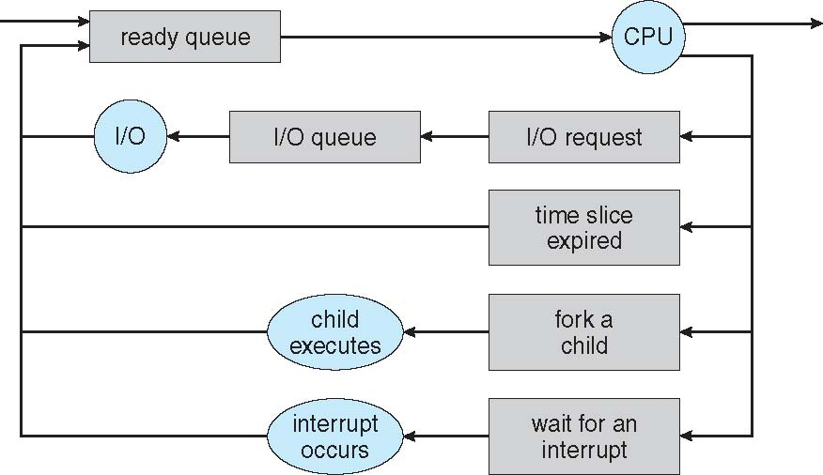
Representation of Process Scheduling
Queueing diagram represents queues, resources, flows

Slide 50
1. Long-Term Scheduler (Job Scheduler)
Long-term scheduler (or job scheduler) – selects which processes should be brought into the ready queue
The Long-Term Scheduler is responsible for loading processes from disk into main memory so they can begin execution.
Transfers processes from the Job Queue to the Ready Queue.
  Long-term scheduler is invoked infrequently (seconds, minutes) ⇒ (may be slow)
  The long-term scheduler controls the degree of multiprogramming
Processes can be described as either:
  I/O-bound process – spends more time doing I/O than computations, many short CPU bursts
  CPU-bound process – spends more time doing computations; few very long CPU bursts
Long-term scheduler strives for good process mix

Slide 51
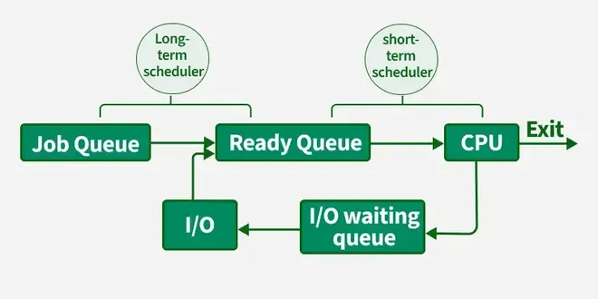
2. Short-Term Scheduler (CPU Scheduler)
Short-term scheduler (or CPU scheduler) – selects which process should be executed next and allocates CPU
  Short-term scheduler is invoked frequently (milliseconds) ⇒ (must be fast)
  The Short-Term Scheduler (STS) is responsible for selecting a process from the ready queue and assigning the CPU to it.
Frequently selects the next process to execute from the ready state.
Maintains fairness by allocating CPU time among processes.
Uses various CPU scheduling algorithms to decide process order.
Maximizes CPU utilization by keeping the processor as busy as possible.

Slide 52
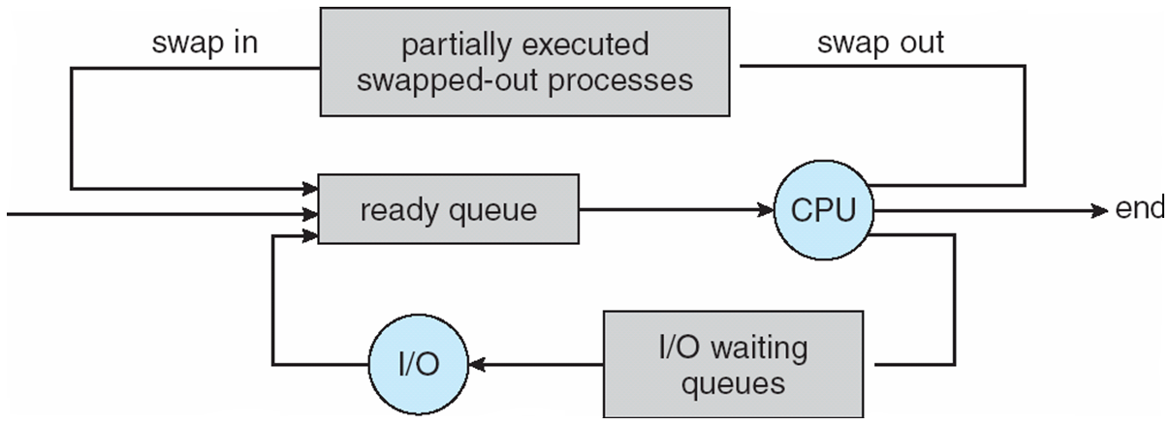
3. Medium-Term Scheduler
Medium-term scheduler can be added if degree of multiple programming needs to decrease
  Remove process from memory, store on disk, bring back in from disk to continue execution: swapping
The Medium-Term Scheduler (MTS) manages swapping, which temporarily moves processes between main memory and disk
Swaps processes out of memory when they are waiting (e.g., blocked for I/O) to reduce the degree of multiprogramming.
Frees memory for other active processes.
It operates faster than the long-term scheduler but slower than the short-term scheduler.

Slide 53
Process context switching
What is Process Context Switching?
Process Context Switching is the process of saving the state of the currently running process and loading the state of another process, so the CPU can switch from one process to another.
OR
Context switching is the process of changing the CPU from executing one process to executing another process.
Definition
Process Context Switching:
It is the mechanism in which the Operating System (OS) saves the execution state (context) of the current process into its Process Control Block (PCB) and restores the saved state of another process from its PCB, allowing the CPU to continue executing the new process.

Slide 54
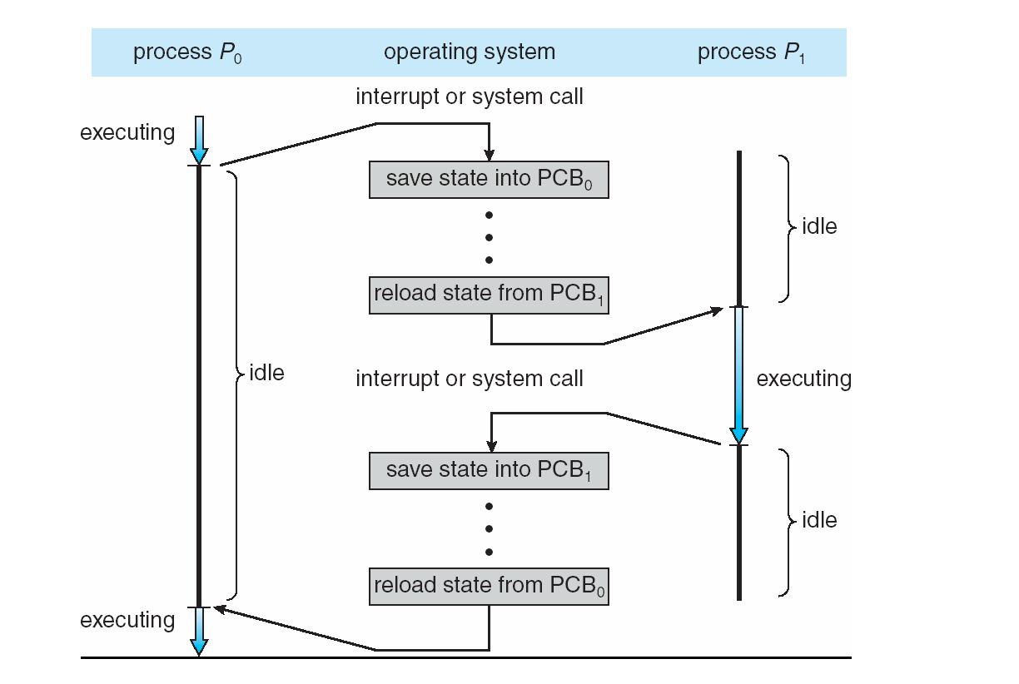
Process context switching

Slide 55
Cont..
Two processes po and p1 that execute in interleaved manner
The CPU alternates execution between two processes — p0 and p1 — through context switching.
1. Execution Phase (Process p0)
Process p0 is running while p1 remains idle.
At some point, an interrupt or system call occurs (e.g., a timer interrupt or I/O completion).
2. Saving Current State (p0 → PCB0)
The operating system pauses p0.
The current state of p0 (register values, program counter, etc.) is saved into its Process Control Block (PCB0).
This ensures that p0 can later resume exactly where it left off.
3. Loading New Process State (PCB1 → p1)
The OS retrieves the saved state of p1 from PCB1.
This step restores p1’s CPU context so it can continue execution from its last saved point.

Slide 56
Cont..
4. Execution Phase (Process p1)
Now, p1 is running while p0 is idle.
Another interrupt or system call occurs, triggering another switch.
5. Saving State of p1 (p1 → PCB1): The OS saves the current state of p1 into PCB1.
6. Reloading State of p0 (PCB0 → p0)
The saved state of p0 from PCB0 is loaded back into the CPU registers.
p0 resumes execution right where it left off.

Slide 57
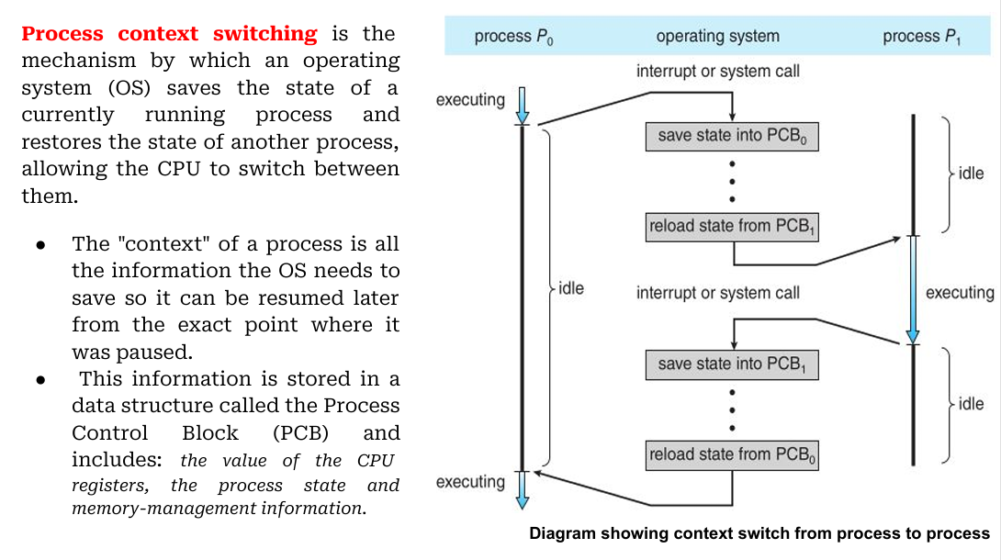
OR

Slide 58
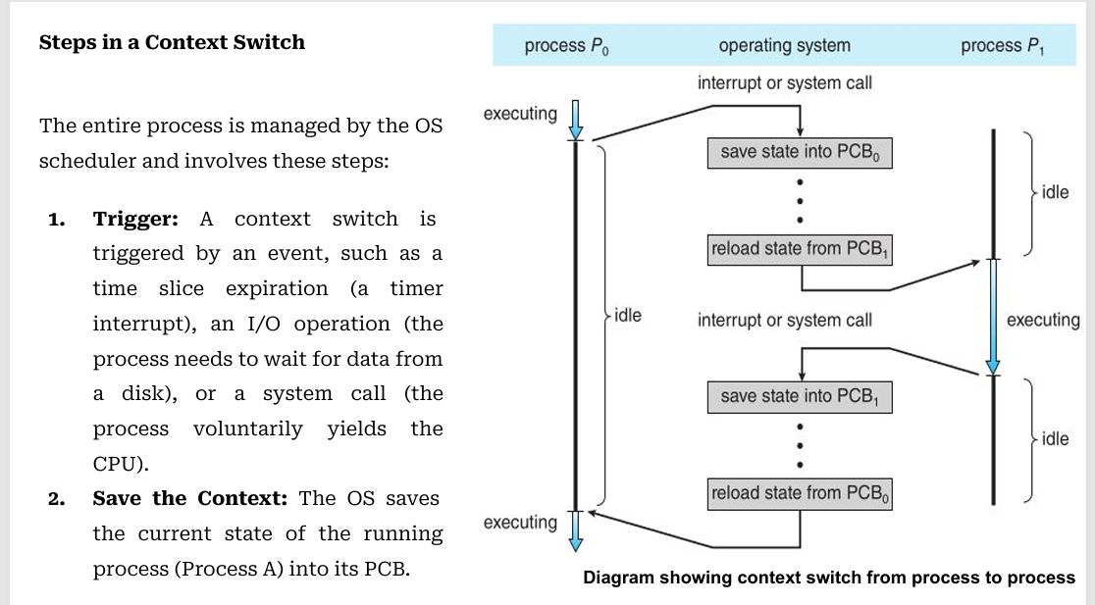
Cont..

Slide 59
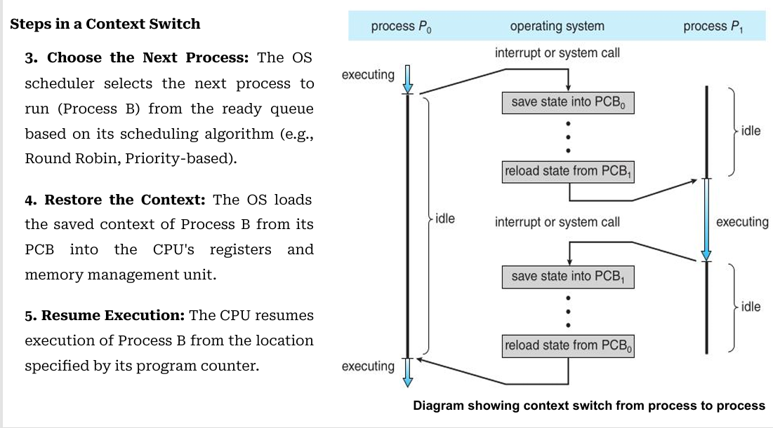
Cont..

Slide 60
scheduling algorithms
What is CPU Scheduling?
CPU Scheduling is the process by which the operating system selects one process from the Ready Queue and allocates the CPU to it for execution.
There are mainly two types of scheduling methods:
Preemptive Scheduling:
Preemptive scheduling is used when a process switches from running state to ready state or from the waiting state to the ready state.
Non-Preemptive Scheduling:
Non-Preemptive scheduling is used when a process terminates , or when a process switches from running state to waiting state.

Slide 61
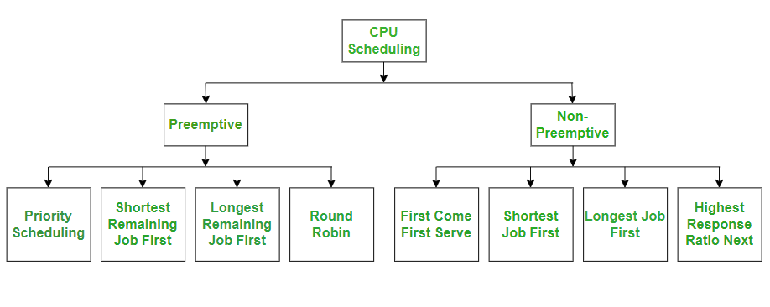
Cont..
.

Slide 62
1.Round Robin (RR)
Round Robin (RR) Scheduling in Operating System
What is Round Robin Scheduling?
Round Robin (RR) is a preemptive CPU scheduling algorithm in which each process gets a fixed amount of CPU time called a Time Quantum (Time Slice).
Each process is executed for one time quantum.
If the process finishes within the time quantum, it leaves the queue.
If it does not finish, it is moved to the end of the Ready Queue.
The CPU continues executing the next process in the queue.
This continues until all processes are completed.
Key Idea
Every process gets an equal chance to execute.

Slide 63
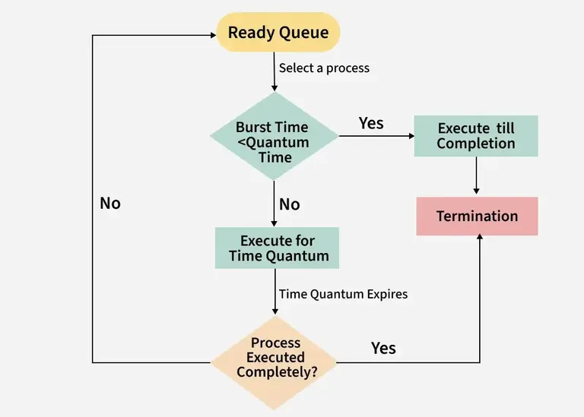
Diagram
Ready Queue
Front Rear
+-----+-----+-----+-----+
| P1 | P2 | P3 | P4 |
+-----+-----+-----+-----+
CPU executes one process for Time Quantum
If completed → Exit
If not completed → Move to Rear

Slide 64
Cont..
Completion Time (CT)
Turnaround Time (TAT) = Completion Time − Arrival Time
Waiting Time (WT) = Turnaround Time − Burst Time
Average Waiting Time
Average Turnaround Time
Note: The Time Quantum (TQ) is chosen by the operating system

Slide 65
2.FCFS (First Come First Serve)
FCFS (First Come First Serve) Scheduling
FCFS (First Come First Serve) is the simplest CPU scheduling algorithm in an Operating System.
Definition
In FCFS scheduling, the process that arrives first gets the CPU first. It follows the FIFO (First In, First Out) principle, just like people standing in a queue at a ticket counter.
First process to enter the ready queue → Executed first.
Non-preemptive scheduling algorithm (once a process starts executing, it cannot be interrupted until it finishes).
Real-Life Example:Imagine there are four students waiting to submit an assignment.
Arrived order student
1st A
2nd B
3rd C
4th D
The teacher checks them in the same order: A → B → C → D
FCFS scheduling works exactly like this

Slide 66
3.Shortest Job First (SJF)
What is Shortest Job First (SJF)?
Shortest Job First (SJF) is a CPU scheduling algorithm in which the process with the smallest CPU burst time is executed first.
CPU Burst Time = Time required by a process to complete its execution.
SJF is mainly used to minimize the average waiting time.
It is one of the most efficient scheduling algorithms when the CPU burst times are known.
Key Features
Non-Preemptive Scheduling (basic SJF)
Executes the shortest job first
Reduces average waiting time
Better CPU utilization

Slide 67
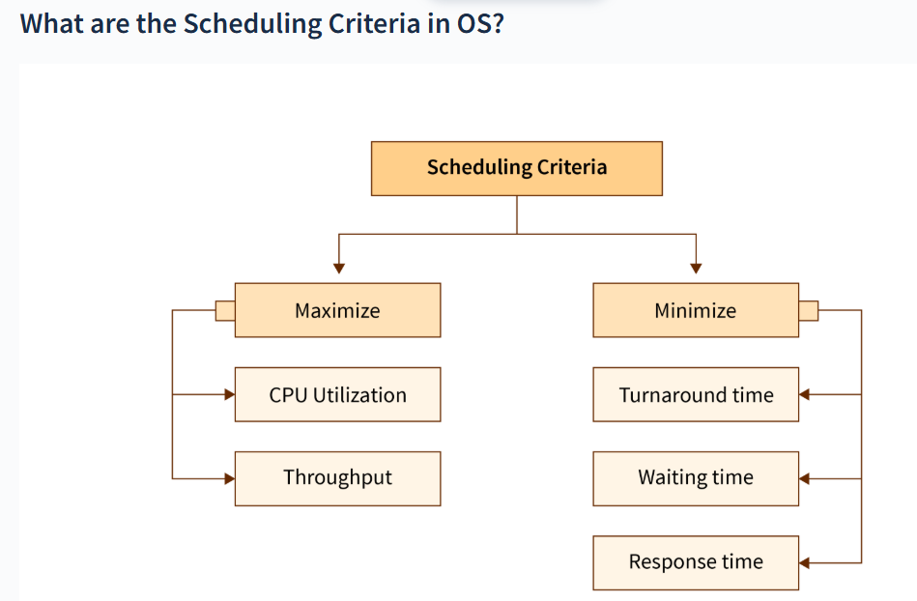
Scheduling criteria

Slide 68
Cont..
Scheduling Criteria are the standards used to evaluate how good a CPU scheduling algorithm is. The scheduler tries to maximize system performance while keeping processes satisfied.
1. CPU utilization: The main objective of any CPU scheduling algorithm is to keep the CPU as busy as possible. Theoretically, CPU utilization can range from 0 to 100 but in a real – time system, it varies from 40 to 90 percent depending on the load upon the system.
Example
CPU works for 90 seconds and is idle for 10 seconds.
CPU Utilization = (90 / 100) × 100 = 90%
Better: Higher CPU utilization.
2. Throughput: A measure of the work done by the CPU is the number of processes being executed and completed per unit of time. This is called throughput. The throughput may vary depending on the length or duration of the processes.
Example : Suppose in 1 minute:
Process P1 completes
Process P2 completes
Process P3 completes
Process P4 completes
Throughput = 4 processes/minute
Better: Higher throughput.

Slide 69
Cont..
3. Turnaround Time (TAT)
Definition: Total time taken from process arrival until its completion.
The time elapsed from the time of submission of a process to the time of completion is known as the turnaround time. Turn-around time is the sum of times spent waiting to get into memory, waiting in the ready queue, executing in CPU and waiting for I/O.
Formula :
Turnaround Time=Completion Time−Arrival Time
4. Waiting Time (WT)
Definition: Total time a process waits in the ready queue before getting the CPU.
A scheduling algorithm does not affect the time required to complete the process once it starts execution. It only affects the waiting time of a process
Formula :
Waiting Time=Turnaround Time−Burst Time

Slide 70
Cont..
5. Completion Time: The completion time is the time when the process stops executing, which means that the process has completed its burst time and is completely executed.
6. Response Time (RT)
Definition: Time from process arrival until it gets the CPU for the first time.
Formula :
Response Time=First Start Time−Arrival Time
Example:
Process | Arrival Time | First Start Time | Response Time
P1 | 3 ms | 5 ms | 5 − 3 = 2 ms

Slide 71
Process management in Unix/Linux Inter Process Communication: Linux IPC Mechanisms
What is IPC?
Inter Process Communication (IPC) is a mechanism that allows two or more processes to exchange data and synchronize their execution.
Why IPC is Needed?
Data sharing
Resource sharing
Synchronization
Communication between parent and child processes
Client-server applications
Real-Time Example
Imagine WhatsApp:
One user sends a message.
Another user receives it.
Similarly, one process sends data and another process receives it using IPC.

Slide 72
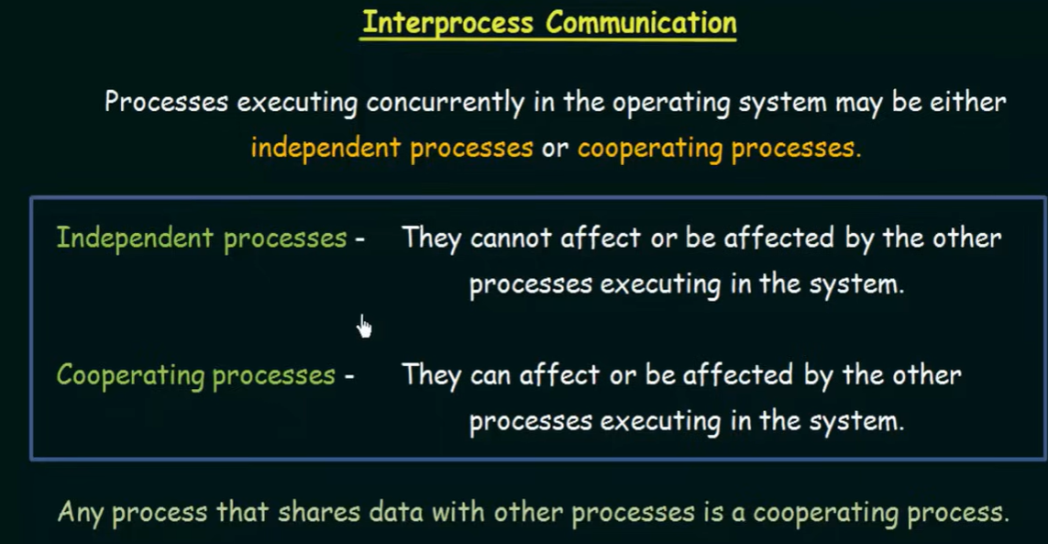
Cont..

Slide 73
Cont..
Cooperating processes require an interprocess communication(IPC) mechanism that will allow them to exchange data and information.
There are two method of IPC, shared memory and message passing. An operating system can implement both methods of communication.
1. Shared Memory
In the shared memory model, a region of memory that is shared by cooperating processes is established.
The processes then exchange information by reading from and writing to the shared memory.
OR
Communication between processes using shared memory requires processes to share a memory segment, the implementation of which is handled by the programmer. Processes can use shared memory for extracting information as a record from another process as well as for delivering any specific information to other processes.

Slide 74
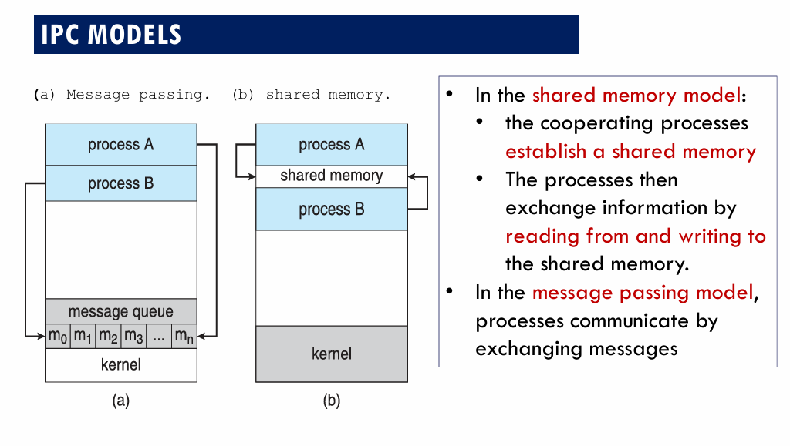
Cont..

Slide 75
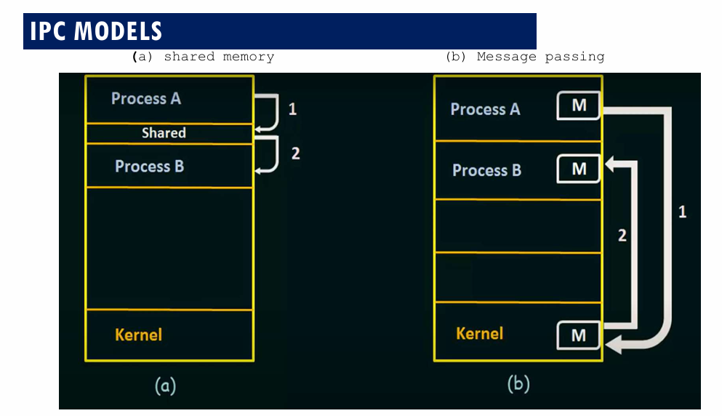
Cont..

Slide 76
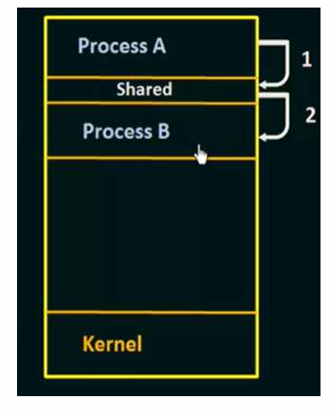
Cont..
In the above shared memory model, a common memory
space is allocated by the kernel.
Process A writes data into the shared memory region (Step 1).
Process B can then directly read this data from the same shared
memory region (Step 2).
Since both processes access the same memory segment, this
method is fast but requires synchronization mechanisms
(like semaphores) to avoid conflicts when multiple processes
read/write simultaneously.
Example: Multiple people can edit the document at the same time in shared google doc.

Slide 77
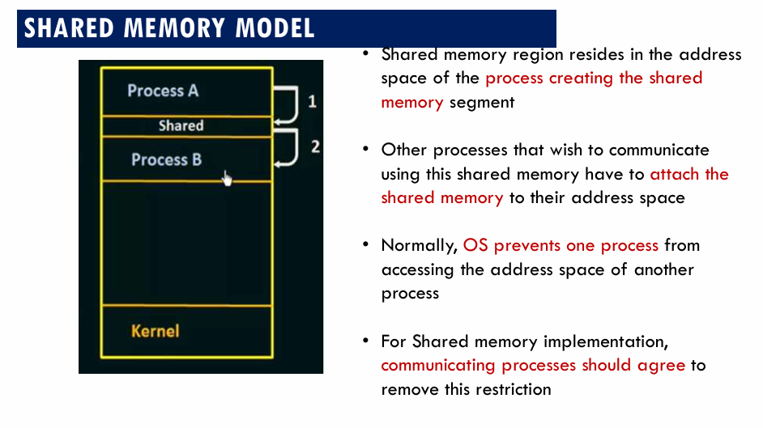
Cont..

Slide 78
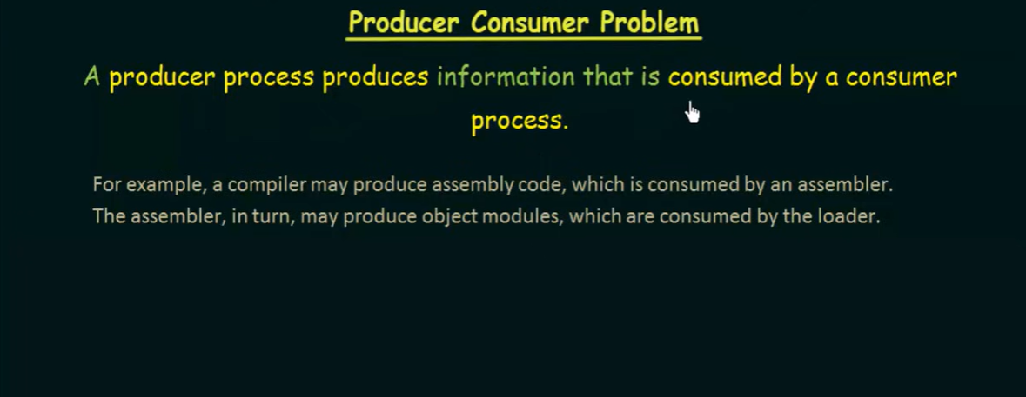
PRODUCER-CONSUMER PROBLEM: SHARED MEMORY SOLUTION

Slide 79
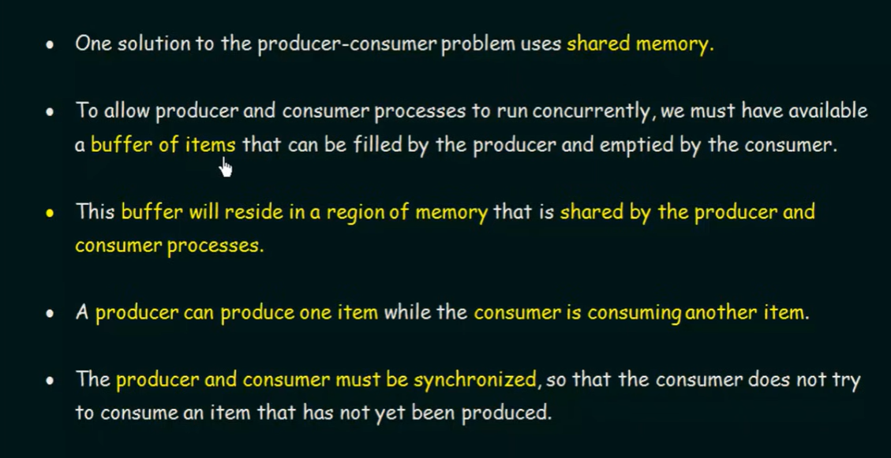
PRODUCER-CONSUMER PROBLEM: SHARED MEMORY SOLUTION

Slide 80
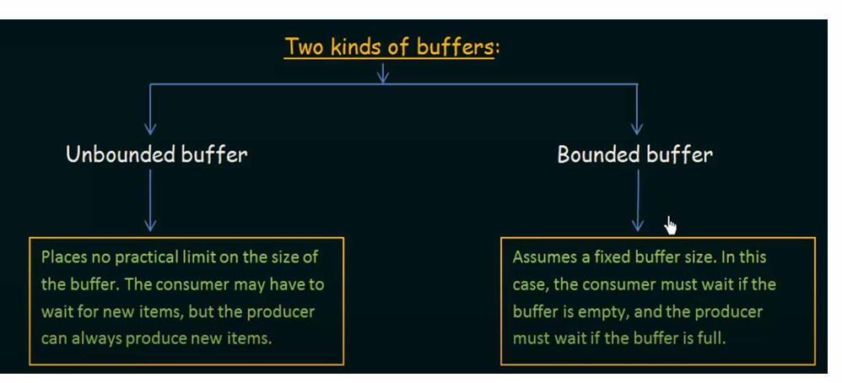
PRODUCER-CONSUMER PROBLEM: SHARED MEMORY SOLUTION

Slide 81
Cont..
2.Message Passing
In the message passing model, communication takes place by means of messages exchanged between the cooperating processes.
In the message passing model, processes communicate by exchanging messages
OR
Message Passing is a method where processes communicate by sending and receiving messages to exchange data. One process sends a message and the other process receives it, allowing them to share information. Message Passing can be achieved through different methods like Sockets, Message Queues or Pipes.

Slide 82
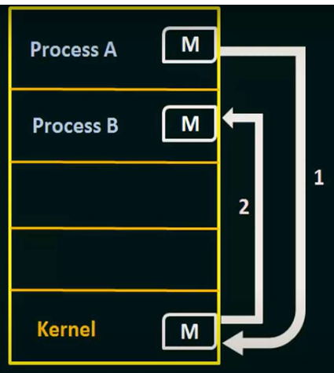
Cont..
In the above message passing model, processes exchange
information by sending and receiving messages through the kernel.
Process A sends a message to the kernel (Step 1).
The kernel then delivers the message to Process B (Step 2).
Here, processes do not share memory directly. Instead, communication
happens via system calls (send(), recv(), or similar).
This method is simpler and safer than shared memory because there’s
no risk of overwriting shared data, but it incurs more overhead due to
kernel involvement.
Example: Multiple people send updates to a group chat, but each message goes through the server before others see it, like processes sending messages instead of directly sharing memory.

Slide 83
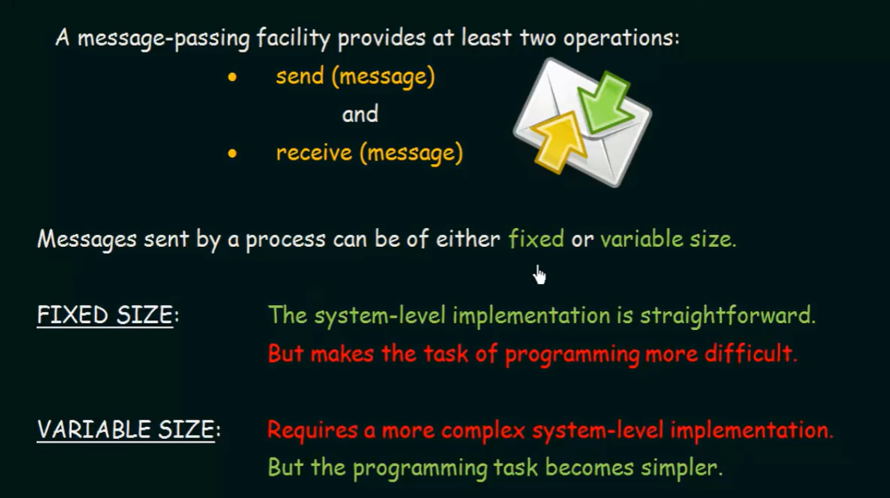
Cont..

Slide 84
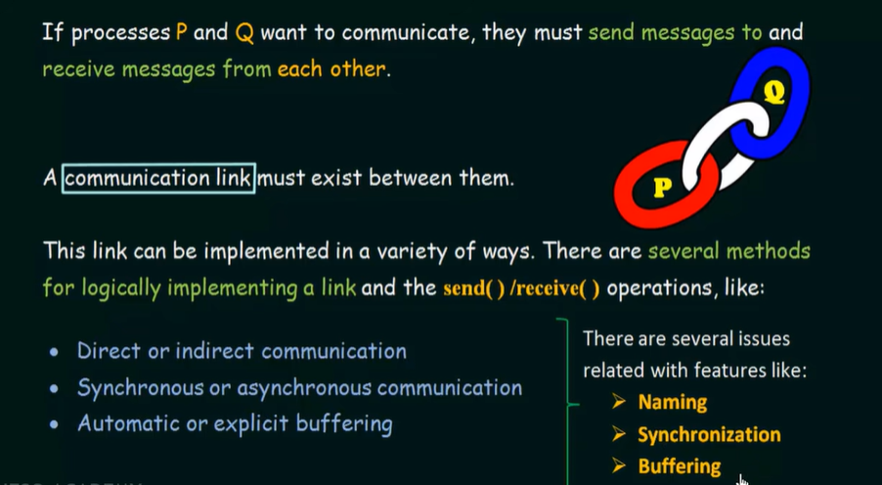
Cont..

Slide 85
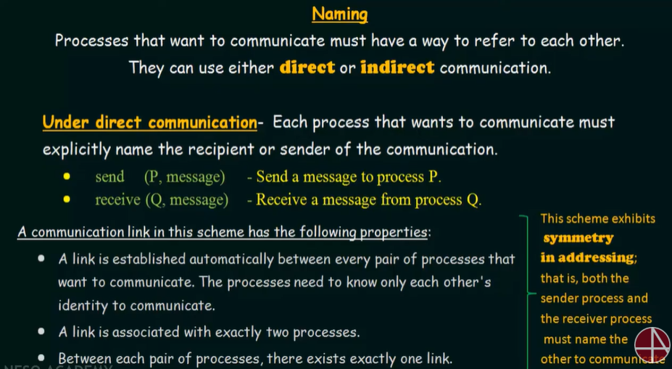
DIRECT COMMUNICATION: NAMING

Slide 86
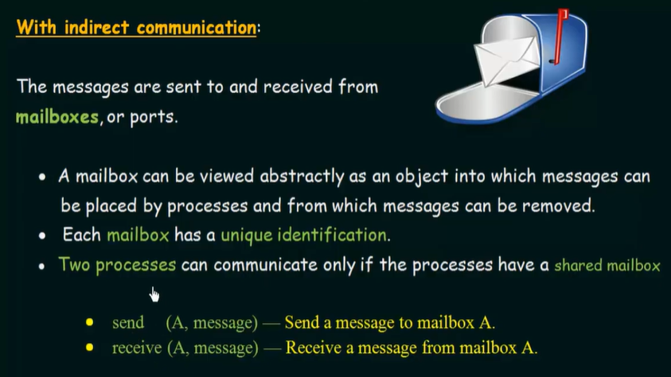
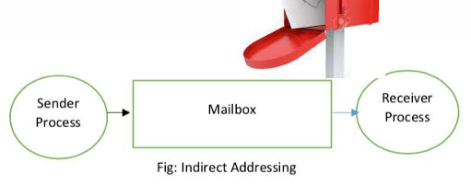
INDIRECT COMMUNICATION

Slide 87
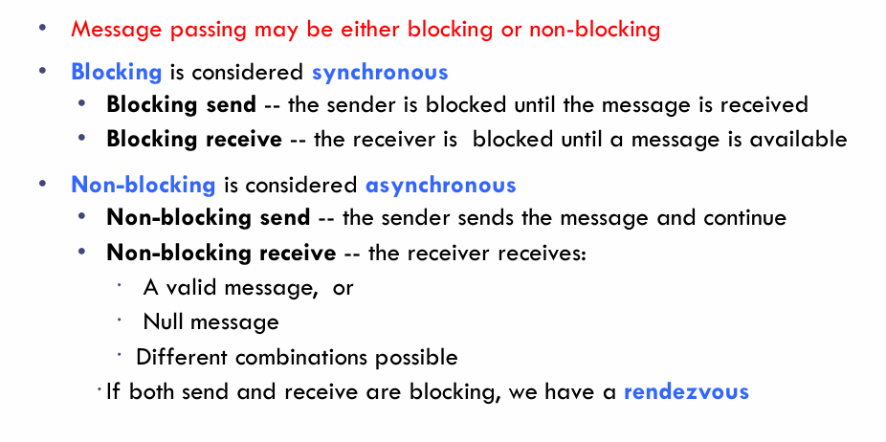
SYNCHRONIZATION

Slide 88
BUFFERING
Whether communication is direct or indirect, messages exchanged by communication processes reside in a temporary queue.
Basically, such queues can be implement in three ways:
Zero capacity : The queue has a maximum length of zero; thus, the link cannot have any messages waiting in it, In this case, the sender must block until the recipient receives the message.
Bounded capacity : finite length of n messages Sender must wait if link full
Unbounded capacity : infinite length Sender never waits
Thus, any number of messages can wait in it, The sender never block.

Slide 89
Linux IPC Mechanisms
Linux provides several IPC mechanisms.
1. Pipe
A Pipe is the simplest IPC mechanism.
Communication between related processes (parent and child).
One-way communication (Half Duplex).
Parent -------> Child
OR
One-way communication channels that allow data to flow from a writer process to a reader process.
2. Named Pipe (FIFO)
A FIFO (First In First Out) is similar to a pipe but has a name in the file system.
Can communicate between unrelated processes.
Bidirectional communication is possible using two FIFOs.
Example command: mkfifo mypipe

Slide 90
Cont..
3. Message Queue
Processes communicate by sending messages.
OR
Processes send messages to a queue that other processes can read from.
Process A
|
Message Queue
|
Process B
4. Shared Memory
Fastest IPC mechanism.
Both processes access the same memory area.
Processes communicate by reading and writing to a shared region of memory.
Shared Memory
+-------------+
| |
Process A Process B

Slide 91
Cont..
5. Semaphore
Synchronization tools that manage access to shared resources by multiple processes
OR
A Semaphore is used for synchronization.
It prevents multiple processes from accessing a shared resource simultaneously.
Example
Only one process can access a printer at a time.
Process 1
|
Semaphore
|
Printer
|
Process 2 waits

Slide 92
Cont...
6. Signals : A method of sending simple notifications or alerts to processes.
OR
Signals are software interrupts used to notify a process about an event.
Examples:
Signal | Meaning
SIGINT | Interrupt (Ctrl + C)
SIGKILL | Forcefully terminate a process
SIGSTOP | Stop a process
SIGCONT | Continue a stopped process

Slide 93
Cont..
7. Sockets
Sockets are used for communication between processes on the same machine or across different machines over a network.
OR
Communication endpoints that can be used for data exchange over a network or between processes on the same machine.
Example:
Web browser ↔ Web server
Client ↔ Server
Client <---------> Server

Slide 94
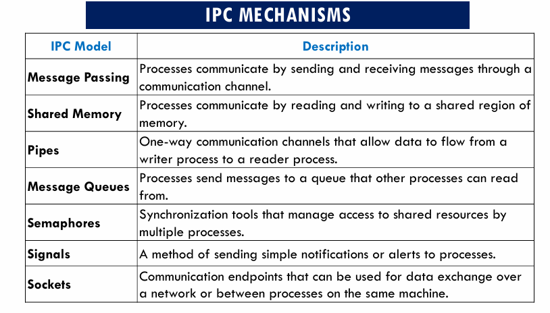
OR

Slide 95
RPC (Remote Procedure Call)
Definition: RPC is a protocol that enables one program to execute procedures or methods on a remote server or computer over a network.
OR
RPC is a communication mechanism that allows a program to call a procedure/function located on another computer as if it were a local function.
OR
RPC is protocol that one program can user to request a service from a program located in another computer on a network without having to understand the network’s details.

Slide 96
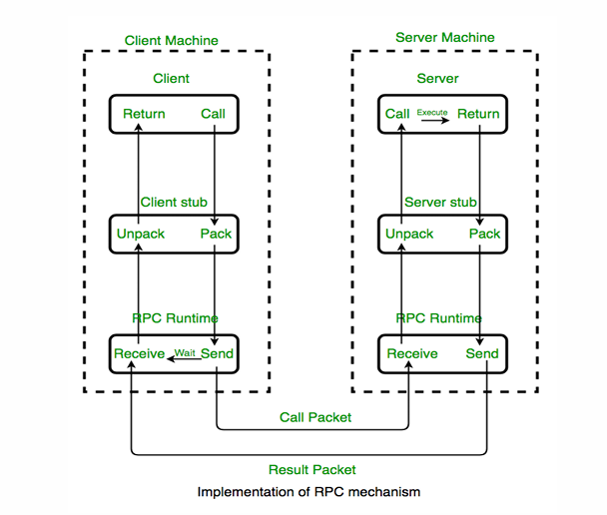
Cont..
Client-Server Model: RPC follows a client-server architecture. The client program initiates the RPC request, and the server program processes the request and sends back the results.

Slide 97
Cont..
How RPC Works (Step by Step)
Client and Server Components
Client: Initiates the request using a local stub.
Server: Hosts the actual implementation of the remote procedure.
Client Calls Stub: The client calls a local procedure (stub) as if it were normal.
Stubs
Client Stub: Packs (marshals) arguments, sends request, and receives results.
Server Stub: Unpacks (unmarshals) arguments, executes the procedure, and sends results back.
Marshalling and Unmarshalling
Marshalling: Converts data/arguments into transmittable byte streams.
Unmarshalling: Converts byte streams back into usable data.
Marshalling: The stub packs (marshals) all input parameters into a message.
Send to Server: The message is sent across the network to the server.
Server Stub: The server stub unpacks the message and calls the actual server procedure.
Execution & Return: The server runs the procedure and returns the result to the stub.
Back to Client: The server stub sends the result back, and the client stub unpacks it.

Slide 98
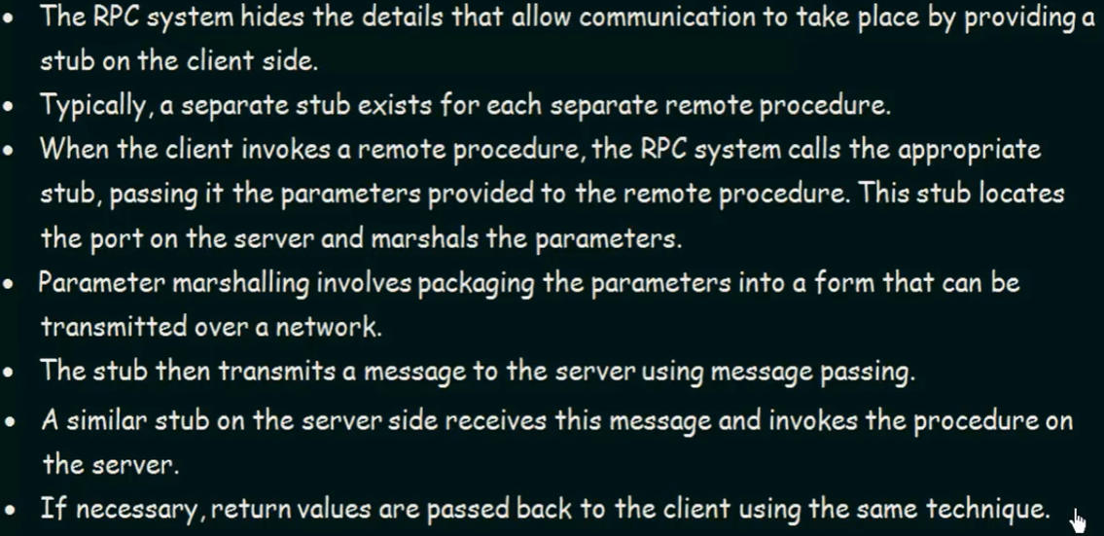
Cont..

Slide 99
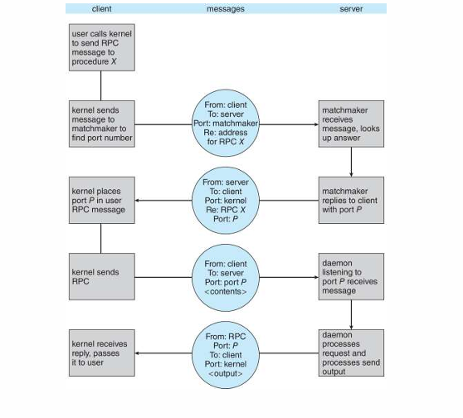
EXECUTION OF RPC

Slide 100
Types of RPC
Callback RPC: Both client and server can act as each other. The server can call back the client, useful in interactive applications. Handles deadlocks and supports peer-to-peer communication.
Broadcast RPC: The client’s request is broadcast to all servers. Special broadcast ports are used. Useful when multiple servers can handle the request.
Batch-mode RPC: Groups multiple client requests and sends them together to the server, reducing network overhead. Best for applications with infrequent calls.

Slide 101
RPC exception handling and Security issues
Exception handling in RPC means handling problems that occur while communicating with or executing a remote procedure.
Unlike a normal local function call, an RPC can fail because of network problems, server failures, timeouts, or invalid requests.
Example
Client → RPC Request → Server
The server is down.
The client cannot simply continue as if the function executed successfully.
It must handle the exception.

Slide 102
Cont..
Exception Types: In an RPC system, exceptions can occur on both the client and server sides. These exceptions can be categorized into two main types:
Application-Level Exceptions:
These exceptions are raised within the remote procedure and are specific to the application's logic. For example, if a remote procedure expects certain input conditions to be met and they are not, it may raise an application-level exception.
System-Level Exceptions:
These exceptions are related to the RPC system itself and may include network errors, connection failures, timeouts, or other issues that prevent the RPC call from completing successfully.

Slide 103
Common RPC exceptions
1. Connection failure
The client cannot connect to the server
Client ───X──→ Server
Connection Failed
Action: Report an error or try another server.
2. Timeout
The server takes too long to respond.
Client → Request → Server
Client ← Waiting...
Client ← TIMEOUT
Action: The client may retry the request.

Slide 104
Cont..
3. Server failure
The server crashes while processing the request.
Client → Server
↓
CRASH
The client receives an error.
4. Invalid parameters
The client sends incorrect data.
Example: calculateSalary(-50000)
The server can reject the request.
5. Network failure
The request or response may be lost during transmission.
Client → Request → X → Server
Lost
The client may retry.

Slide 105
RPC exception-handling methods
1. Retry
Request → Server
↓
Failure
↓
Retry
2. Timeout
If there is no response within a specified time, generate an exception.
3. Error message
The server sends an error such as:
"Service unavailable"
"Invalid request"
"Permission denied"
4. Fallback
The client can use another available server.

Slide 106
Security Issues in RPC
RPC involves communication between different machines, so security is very important.
1. Authentication
Question: Who is making the RPC request?
The system should verify the identity of the client.
Example:
Client → Username + Password/Token
↓
Server verifies identity
2. Authorization
Authentication tells us who you are.
Authorization determines what you are allowed to do.
Example: Employee → View salary ✓
Employee → Delete salary database ✗

Slide 107
Cont..
3. Data confidentiality
RPC messages may contain sensitive information.
Example : Password
Bank account details
Personal information
Attackers should not be able to read the data.
Solution: Use encryption such as TLS.
Client
↓
Encrypted RPC message
↓
Server

Slide 108
Cont..
4. Data integrity
An attacker might modify the RPC message during transmission.
Original:
Transfer ₹1,000
Attacker changes:
Transfer ₹10,000
Security mechanisms such as message authentication codes (MACs) or digital signatures can help detect modification.
5. Replay attack
An attacker captures a valid RPC request and sends it again.
Example:
Original:
Transfer ₹1,000
Attacker records request
↓
Sends same request again
↓
Another ₹1,000 transferred
Solutions : Nonces Timestamps Request IDs Sequence numbers

Slide 109
Cont..
6. Impersonation
An attacker may pretend to be a legitimate client or server.
Real Client → Attacker → Server
Solution: Strong authentication and certificates.
7. Denial of Service (DoS)
An attacker sends a huge number of RPC requests.
Attacker
↓↓↓↓↓↓↓↓↓
RPC Server
↓
Server overloaded
Solutions:
Rate limiting
Authentication
Request limits
Firewalls
Monitoring

Slide 110
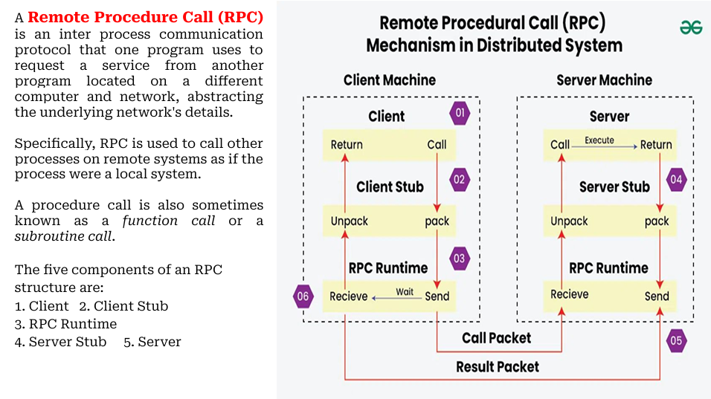
OR

Slide 111
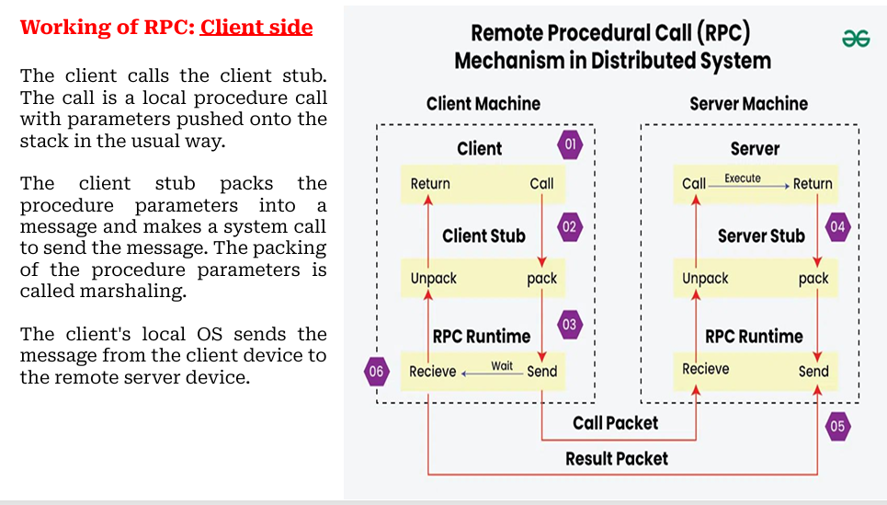
Cont..

Slide 112
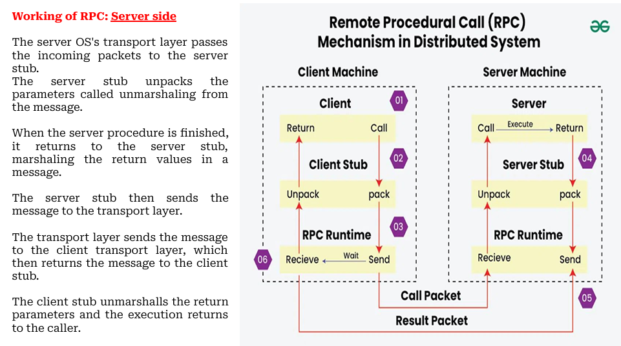
Cont..

Slide 113
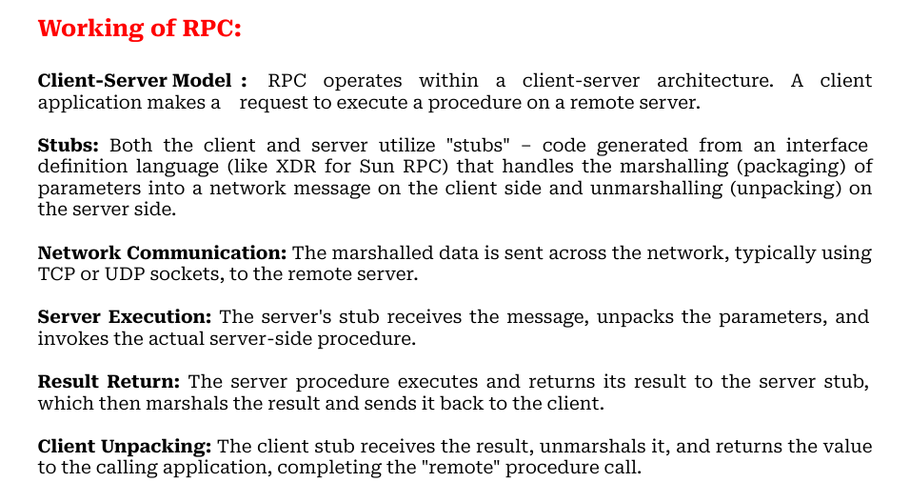
Cont..

Slide 114
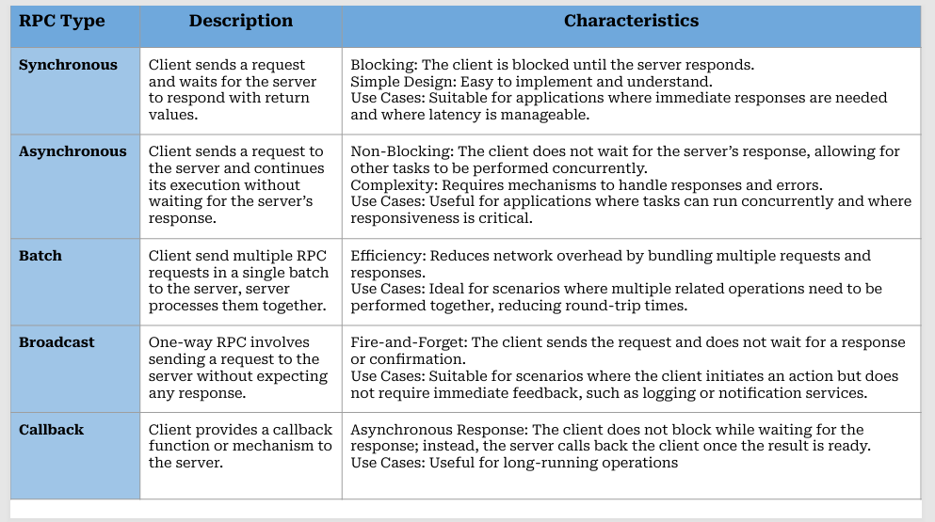
Cont..

Slide 115

Cont..

Slide 116

Cont..

Slide 117
.
THANK YOU
Mr.B.Sai Kumar
Assistant Professor CSE Department

